Slide 1
Assessing and Comparing the Accuracy of Various Bootstrap Methods
Angela Zhu
Mentor: Dr. John Kolassa

Slide 2
Bootstrapping
A method for estimating the sampling distribution of a statistic.
Often considered a resampling procedure that employs numerical approximations.
Various techniques for computing confidence intervals using only the information contained in data sets.
Notes:
Bootstrapping is useful when properties of the underlying distribution are unknown.

Slide 3
Project Description
Evaluate performance of various bootstrap methods for constructing confidence intervals for mean and median of common distributions
  Coverage Percentage
  Average Confidence Interval Length
Bootstrap Hazard Ratio
Accelerated Failure Time Model

Slide 4
Distributions Considered
Symmetrical Distribution
  Standard Normal N(0,1)
  Standard Uniform U(0,1)
  Standard Cauchy (location 0 and scale 1)
  Laplace with location 0 and scale 1
Non-symmetrical Distribution
  Gamma Distribution
    Shape=1, scale=2
    Shape=4, scale=1
Notes:
Statisticians often make inference based on a summary statistic like a mean; the distribution of the summary statistic is dependent on the distribution of the underlying components of the mean, which we often do not know. Thus, we need a method that works well for a variety of these distributions.
Many procedures are built with normal variables in mind.
Uniform is chosen to demonstrate the procedures for lighter tails.
Cauchy demonstrates behavior for tails so heavy that many conventional methods fail.
Laplace is chosen for heavier tails.
Gamma distributions represent skewed distributions.

Slide 5
Methods
Sample sizes of 10, 20, 50
  Randomly generated using R
Generate 5 types of bootstrap confidence intervals
  First order normal approximation
  Basic bootstrap
  Studentized bootstrap (using both variance and IQR²)
  Bootstrap percentile
  Adjusted bootstrap percentile (BCA)
t-test method
999 bootstrap replicates of sample mean or median
Monte Carlo simulation of 10,000 bootstrap confidence intervals
Notes:
boot and boot.ci in R
For each distribution considered, samples of the same size as that of the original sample were drawn with replacement from the original sample, and bootstrap replicates of the statistic for each bootstrap sample were generated.

Slide 6
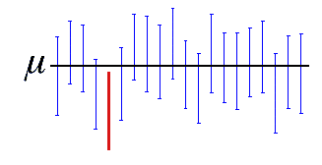

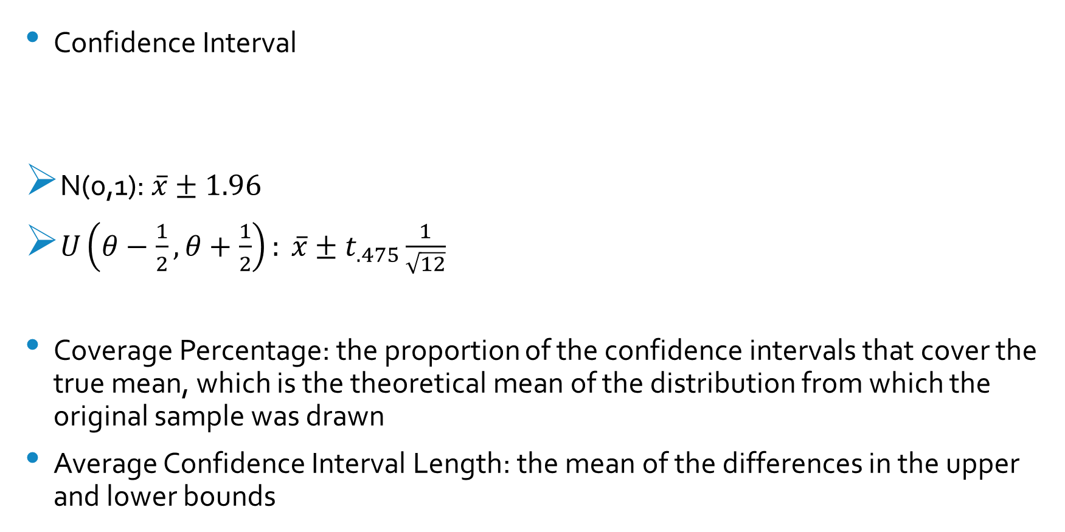
Measurements
Confidence Interval
N(0,1): $\overline{x}±1.96$
$U\left(θ−\frac{1}{2},θ+\frac{1}{2}\right): \overline{x}±t_{.475}\frac{1}{\sqrt{12}}$
Coverage Percentage: the proportion of the confidence intervals that cover the true mean, which is the theoretical mean of the distribution from which the original sample was drawn
Average Confidence Interval Length: the mean of the differences in the upper and lower bounds
Notes:
Interpretation: In repeated sampling, if we constructed 95% confidence intervals for each sample, 95% of them are expected to contain the true value.
The confidence interval depends on the underlying distribution.
NOTE: Although the mean for the Cauchy distribution is undefined, for our purposes, we assumed the true mean to be equal to the location parameter.
Poor performance is characterized by coverage deviating from .95 and large confidence interval lengths. Undercoverage is of greater concern than overcoverage.

Slide 7
Results

Slide 8
Coverage for Mean (n=10)
 | n | Normal | Basic | Studentized | Studentized with IQR2 | Percentile | BCA | t
Normal | 10 | 0.9077 | 0.9072 | 0.9525 | 0.9508 | 0.9048 | 0.9045 | 0.9515
Uniform | 10 | 0.8995 | 0.8867 | 0.9739 | 0.9784 | 0.9096 | 0.9316 | 0.9437
Cauchy | 10 | 0.9452 | 0.9588 | 0.9215 | 0.8076 | 0.8760 | 0.7847 | 0.9779
Laplace | 10 | 0.9134 | 0.9239 | 0.9279 | 0.9010 | 0.8979 | 0.8672 | 0.9582
Gamma a=1,s=2 | 10 | 0.8586 | 0.8441 | 0.9455 | 0.9390 | 0.8625 | 0.8782 | 0.9036
Gamma a=4,s=1 | 10 | 0.8847 | 0.8804 | 0.9465 | 0.9491 | 0.8876 | 0.8900 | 0.9340
 | n | Normal | Basic | Studentized | Studentized with IQR2 | Percentile | BCA | t
Normal | 10 | -0.0423 | -0.0428 | 0.0025 | 0.0008 | -0.0452 | -0.0455 | 0.0015
Uniform | 10 | -0.0505 | -0.0633 | 0.0239 | 0.0284 | -0.0404 | -0.0184 | -0.0063
Cauchy | 10 | -0.0048 | 0.0088 | -0.0285 | -0.1424 | -0.074 | -0.1653 | 0.0279
Laplace | 10 | -0.0366 | -0.0261 | -0.0221 | -0.0490 | -0.0521 | -0.0828 | 0.0082
Gamma a=1,s=2 | 10 | -0.0914 | -0.1059 | -0.0045 | -0.0110 | -0.0875 | -0.0718 | -0.0464
Gamma a=4,s=1 | 10 | -0.0653 | -0.0696 | -0.0035 | -0.0009 | -0.0624 | -0.0600 | -0.0160
Notes:
Standard t-test appears to have the best performance across the symmetrical distributions. This is followed by the Studentized bootstrap method that employs the variance of the sample.
For samples taken from the Cauchy distribution, the Normal and Basic bootstrap methods demonstrate better performance.
For sample size 10 taken from the gamma distributions, the Studentized bootstrap methods result in approximate 95% coverage percentages.

Slide 9
Coverage for Mean (n=20)
 | n | Normal | Basic | Studentized | Studentized with IQR2 | Percentile | BCA | t
Normal | 20 | 0.9281 | 0.9280 | 0.9507 | 0.9511 | 0.9273 | 0.9262 | 0.9510
Uniform | 20 | 0.9309 | 0.9250 | 0.9683 | 0.9805 | 0.9344 | 0.9478 | 0.9515
Cauchy | 20 | 0.9634 | 0.9760 | 0.9016 | 0.8548 | 0.8975 | 0.7858 | 0.9788
Laplace | 20 | 0.9297 | 0.9377 | 0.9270 | 0.8903 | 0.9205 | 0.8997 | 0.9533
Gamma a=1,s=2 | 20 | 0.8953 | 0.8846 | 0.9455 | 0.9303 | 0.9031 | 0.9107 | 0.9173
Gamma a=4,s=1 | 20 | 0.9202 | 0.9163 | 0.9504 | 0.9447 | 0.9224 | 0.9243 | 0.9446
 | n | Normal | Basic | Studentized | Studentized with IQR2 | Percentile | BCA | t
Normal | 20 | -0.0219 | -0.0220 | 0.0007 | 0.0011 | -0.0227 | -0.0238 | 0.0010
Uniform | 20 | -0.0191 | -0.0250 | 0.0183 | 0.0305 | -0.0156 | -0.0022 | 0.0015
Cauchy | 20 | 0.0134 | 0.0260 | -0.0484 | -0.0952 | -0.0525 | -0.1642 | 0.0288
Laplace | 20 | -0.0203 | -0.0123 | -0.0230 | -0.0597 | -0.0295 | -0.0503 | 0.0033
Gamma a=1,s=2 | 20 | -0.0547 | -0.0654 | -0.0045 | -0.0197 | -0.0469 | -0.0393 | -0.0327
Gamma a=4,s=1 | 20 | -0.0298 | -0.0337 | 0.0004 | -0.0053 | -0.0276 | -0.0257 | -0.0054
Notes:
The coverage for the various bootstrap methods for samples from the Normal, Uniform, and Laplace distribution become closer to the desired coverage percentage with an increase in sample size.
However, the coverages for the Cauchy distribution remain similar or become worse.
Coverage percentages for samples of size 20 taken from the gamma distributions are similar to those for samples of size 10 except errors are smaller in magnitude.

Slide 10
Coverage for Mean (n=50)
 | n | Normal | Basic | Studentized | Studentized with IQR2 | Percentile | BCA | t
Normal | 50 | 0.9418 | 0.9426 | 0.9499 | 0.9544 | 0.9431 | 0.9419 | 0.9507
Uniform | 50 | 0.9423 | 0.9399 | 0.9602 | 0.9770 | 0.9446 | 0.9489 | 0.9501
Cauchy | 50 | 0.9729 | 0.9853 | 0.8930 | 0.9515 | 0.9076 | 0.7899 | 0.9793
Laplace | 50 | 0.9462 | 0.9498 | 0.9416 | 0.9233 | 0.9424 | 0.9300 | 0.9550
Gamma a=1,s=2 | 50 | 0.9271 | 0.9202 | 0.9495 | 0.9423 | 0.9306 | 0.9345 | 0.9348
Gamma a=4,s=1 | 50 | 0.9426 | 0.9416 | 0.9547 | 0.9529 | 0.9423 | 0.9451 | 0.9488
 | n | Normal | Basic | Studentized | Studentized with IQR2 | Percentile | BCA | t
Normal | 50 | -0.0082 | -0.0074 | -0.0001 | 0.0044 | -0.0069 | -0.0081 | 0.0007
Uniform | 50 | -0.0077 | -0.0101 | 0.0102 | 0.0270 | -0.0054 | -0.0011 | 0.0001
Cauchy | 50 | 0.0229 | 0.0353 | -0.0570 | 0.0015 | -0.0424 | -0.1601 | 0.0293
Laplace | 50 | -0.0038 | -0.0002 | -0.0084 | -0.0267 | -0.0076 | -0.0200 | 0.0050
Gamma a=1,s=2 | 50 | -0.0229 | -0.0298 | -0.0005 | -0.0077 | -0.0194 | -0.0155 | -0.0152
Gamma a=4,s=1 | 50 | -0.0074 | -0.0084 | 0.0047 | 0.0029 | -0.0077 | -0.0049 | -0.0012
Notes:
The coverage for the bootstrap methods for samples taken from all the distributions other than the Cauchy continues to improve with increasing the sample sizes to 50.
For the Cauchy distribution, coverage percentages for the bootstrap methods other than the Studentized with IQR² method diverge further from the desired 95%.
For the gamma distribution with shape 4 and scale 1, the coverage percentages for the bootstrap method are all quite satisfactory and are similar to the results from the Normal distribution. This may be attributed to the Central Limit Theorem.
The inconsistency of the bootstrap results for the Cauchy distribution with the trend observed for the other distributions may be due to the nature of the distribution—lack of expectation and variance.

Slide 11
Average CI Length for Mean (n=10)
 | n | Normal CI Length | Basic CI Length | Studentized CI Length | Studentized with IQR2 CI Length | Percentile CI Length | BCA CI Length | t CI Length
Normal | 10 | 1.145 | 1.144 | 1.505 | 2.205 | 1.144 | 1.164 | 1.393
Uniform | 10 | 0.334 | 0.334 | 0.444 | 0.789 | 0.334 | 0.337 | 0.407
Cauchy | 10 | 33.342 | 28.431 | 180321.919 | 50.848 | 28.431 | 41.633 | 41.239
Laplace | 10 | 1.573 | 1.568 | 2.155 | 2.665 | 1.568 | 1.635 | 1.915
Gamma a=1,s=2 | 10 | 2.190 | 2.164 | 3.819 | 5.361 | 2.164 | 2.358 | 2.666
Gamma a=4,s=1 | 10 | 2.247 | 2.239 | 3.143 | 4.518 | 2.239 | 2.321 | 2.734
Notes:
In assessing average confidence interval length for the bootstrap replicates of the mean, the ones obtained from the Cauchy distribution are much larger than those from the other distributions. Disregarding the confidence interval lengths for the Cauchy distribution because they would dominate the graphs, we will compare the lengths produced by the bootstrap methods of interests.
Average confidence interval lengths from the Normal approximation bootstrap, Basic bootstrap, Percentile bootstrap, and BCA bootstrap methods were similar across distributions and gave the smallest confidence interval lengths. The average length for confidence intervals constructed for the mean using the t-test was slightly larger. On the other hand, Studentized bootstrap method using IQR²resulted in the greatest average confidence interval length.

Slide 12
Average CI Length for Mean (n=20)
 | n | Normal CI Length | Basic CI Length | Studentized CI Length | Studentized with IQR2 CI Length | Percentile CI Length | BCA CI Length | t CI Length
Normal | 20 | 0.842 | 0.844 | 0.941 | 1.056 | 0.844 | 0.849 | 0.923
Uniform | 20 | 0.245 | 0.245 | 0.274 | 0.342 | 0.245 | 0.246 | 0.268
Cauchy | 20 | 21.344 | 18.154 | 6378.682 | 23.007 | 18.154 | 28.177 | 23.393
Laplace | 20 | 1.171 | 1.174 | 1.338 | 1.347 | 1.174 | 1.199 | 1.283
Gamma a=1,s=2 | 20 | 1.635 | 1.630 | 2.123 | 2.223 | 1.630 | 1.738 | 1.791
Gamma a=4,s=1 | 20 | 1.675 | 1.676 | 1.940 | 2.131 | 1.676 | 1.714 | 1.836

Slide 13
Average CI Length for Mean (n=50)
 | n | Normal CI Length | Basic CI Length | Studentized CI Length | Studentized with IQR2 CI Length | Percentile CI Length | BCA CI Length | t CI Length
Normal | 20 | 0.547 | 0.549 | 0.570 | 0.592 | 0.549 | 0.550 | 0.567
Uniform | 20 | 0.158 | 0.158 | 0.165 | 0.178 | 0.158 | 0.159 | 0.164
Cauchy | 20 | 69.494 | 56.402 | 1638797.518 | 63.445 | 56.402 | 91.588 | 71.262
Laplace | 20 | 0.768 | 0.771 | 0.805 | 0.800 | 0.771 | 0.776 | 0.795
Gamma a=1,s=2 | 20 | 1.076 | 1.077 | 1.195 | 1.201 | 1.077 | 1.114 | 1.115
Gamma a=4,s=1 | 20 | 1.087 | 1.090 | 1.152 | 1.183 | 1.090 | 1.101 | 1.126
Notes:
These results transfer to the average lengths obtained for sample sizes 20 and 50. However, increasing the sample size results in convergence of the lengths produced by the different bootstrap methods.

Slide 14
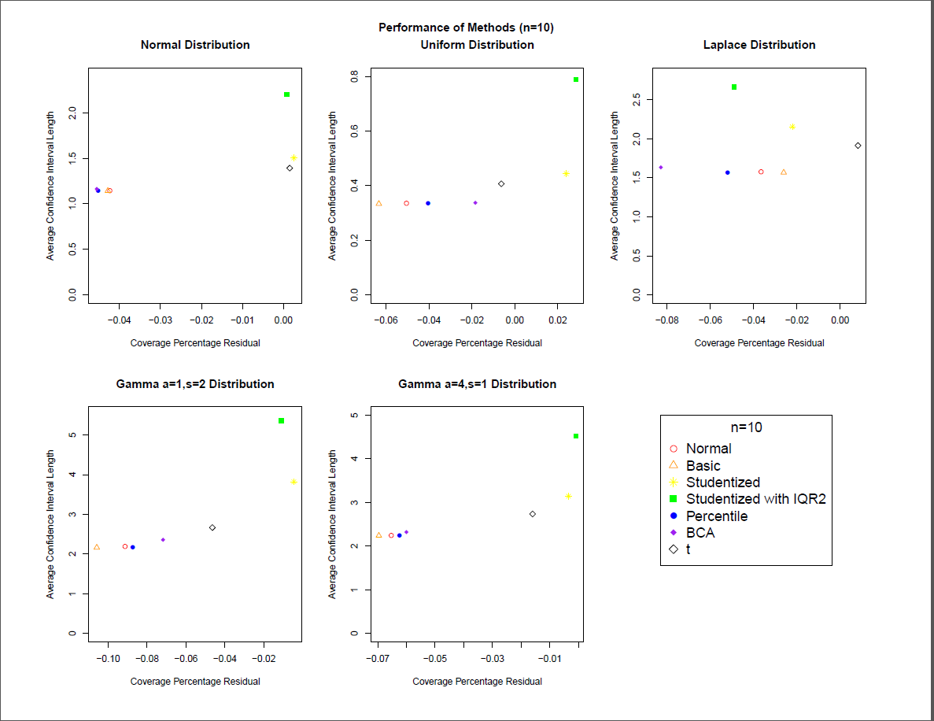
Notes:
The two indications of performance of a bootstrap method do not reinforce each other. For instance, while the t-test method and Studentized bootstrap method tend to give the best coverage (closest to 95%), they also give the larger average confidence interval length.
Performance of the method will be assessed by the proximity of the point to the origin with closer points indicating better performance.
Overall, t-test method and Studentized bootstrap method perform best.

Slide 15
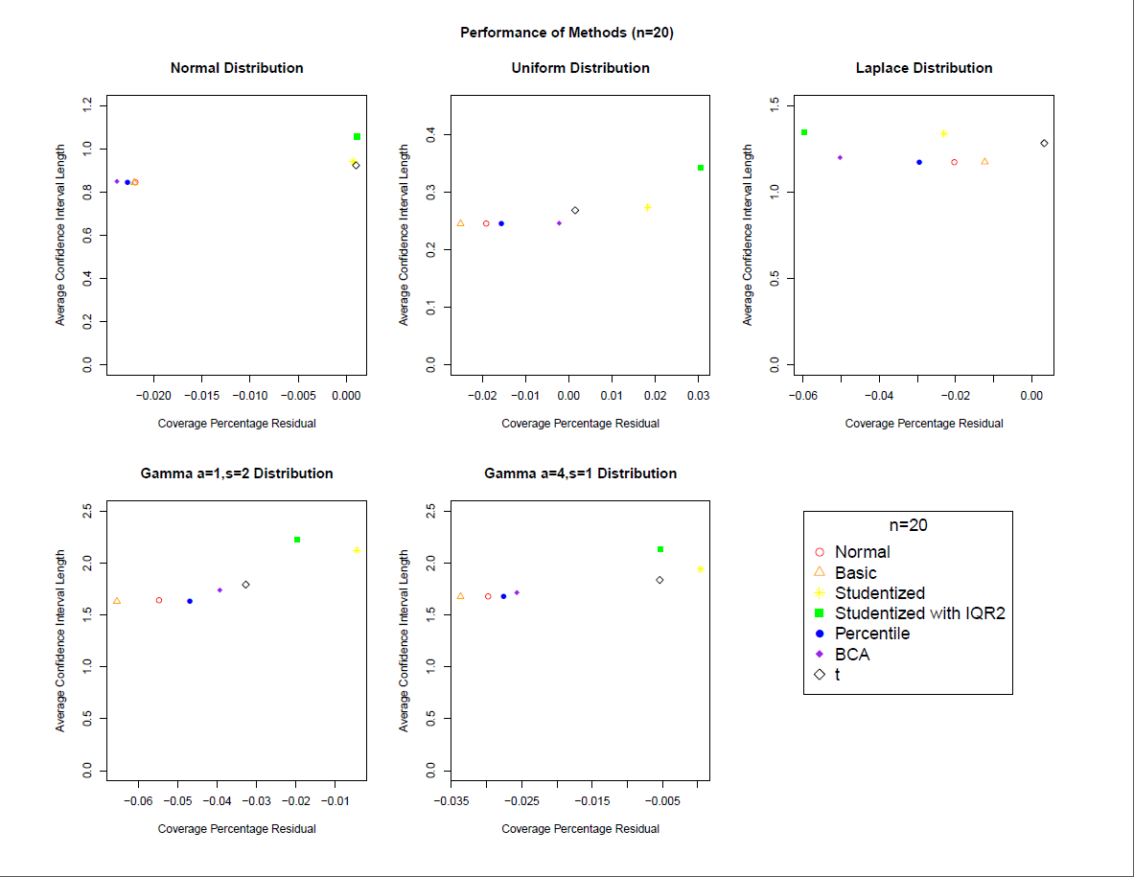

Slide 16
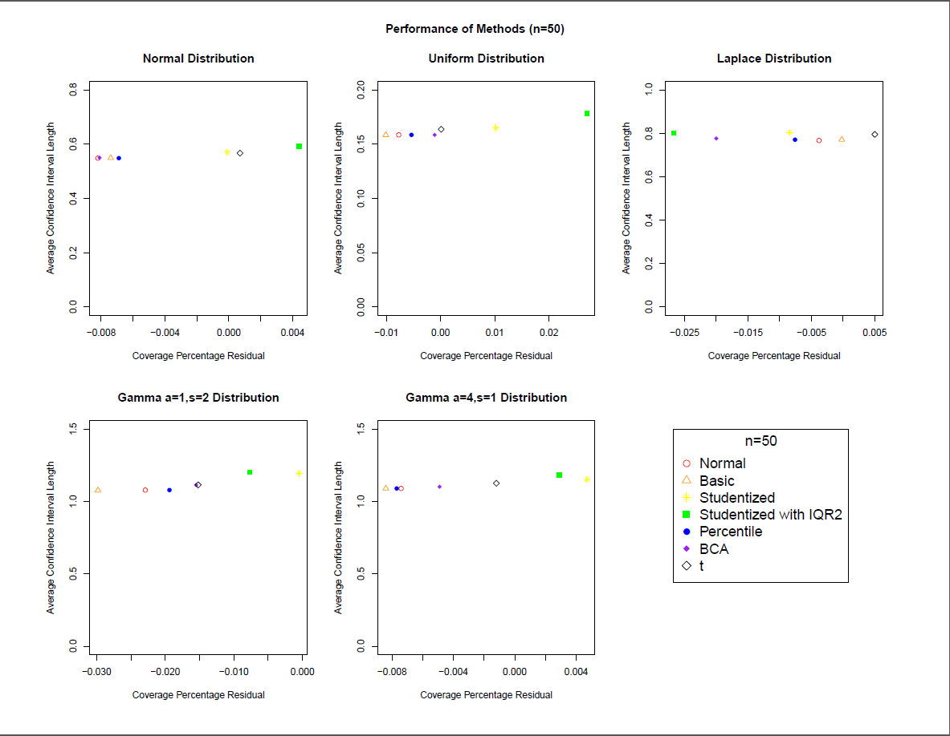
Notes:
For sample size 50, the average confidence interval lengths for the various methods converge, so performance can be evaluated by looking at the coverage percentage residuals. That is, they follow the results obtained when solely considering coverage percentage residuals for samples of size 50.

Slide 17
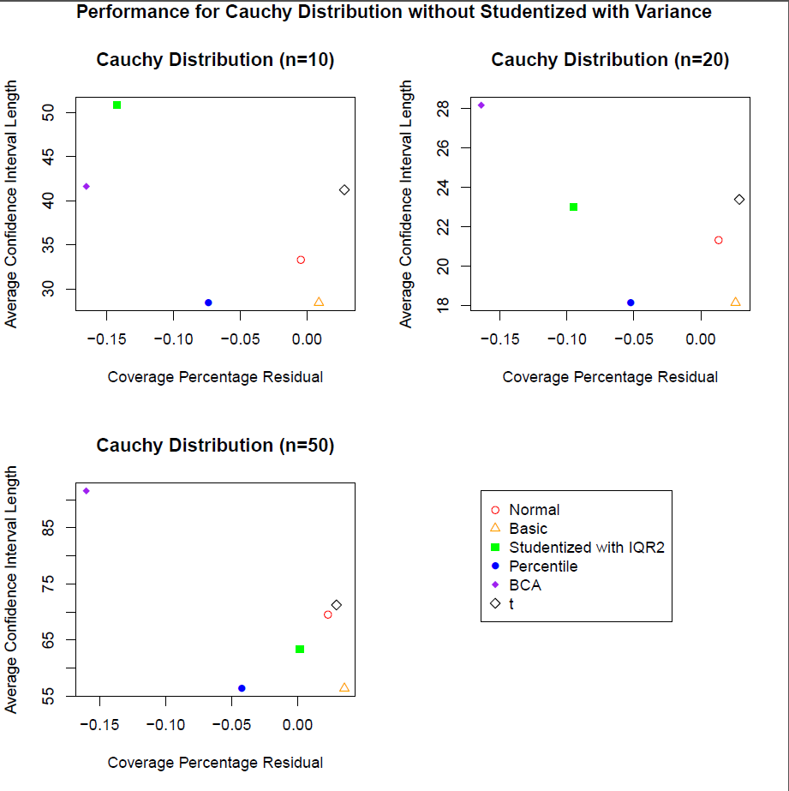
Notes:
For the Cauchy distribution, preliminary scatter plots depicting average confidence interval length vs. coverage percentage residual indicate that the Studentized bootstrap method using variance results in very large lengths that dominate the graph. These points were excluded.
For sample size 10, the Basic bootstrap method had the best performance, followed by the Normal approximation bootstrap method. As the mean and variance of the Cauchy distribution are undefined, a larger sample size does not improve accuracy of the estimates.

Slide 18
Acknowledgements
I would like to thank Dr. Kolassa for giving me this amazing opportunity to learn and engage in statistics research and for his guidance throughout the entire process.
I would also like to thank NSF for funding my project.

